Slide 1

Watson Career and Alumni Connections Office
GlobalFoundries Recruitment Opportunities

Slide 2
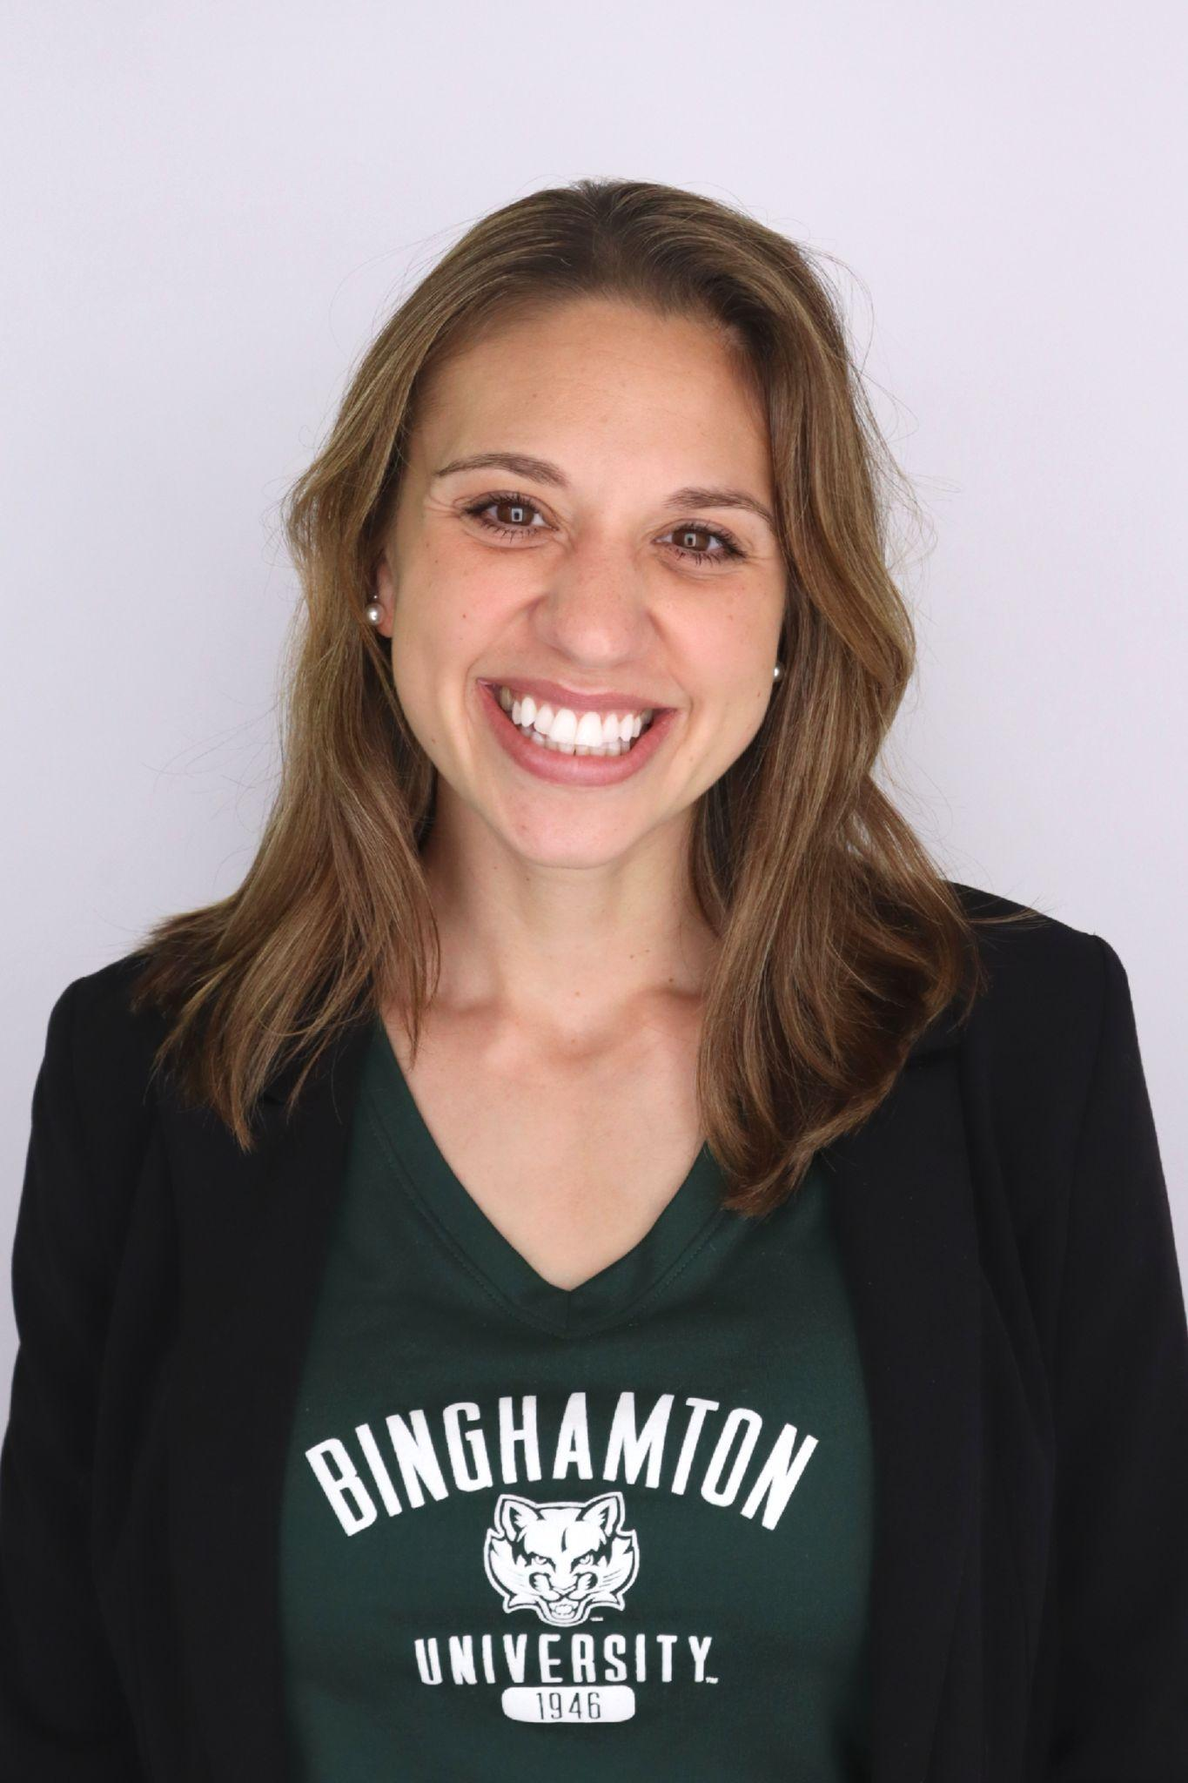
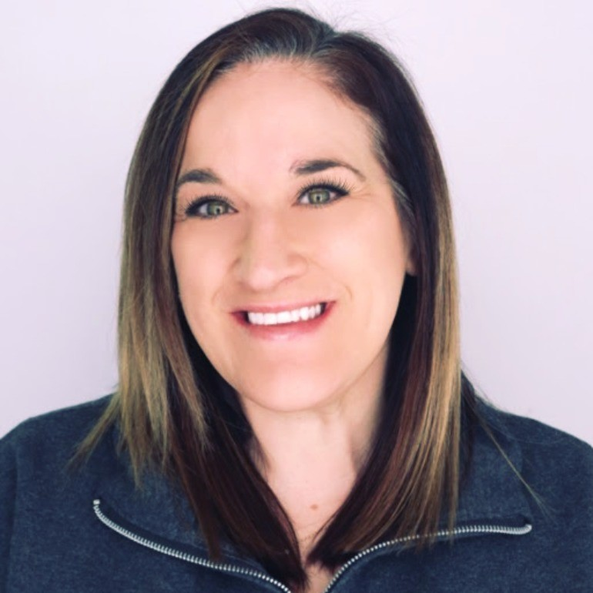

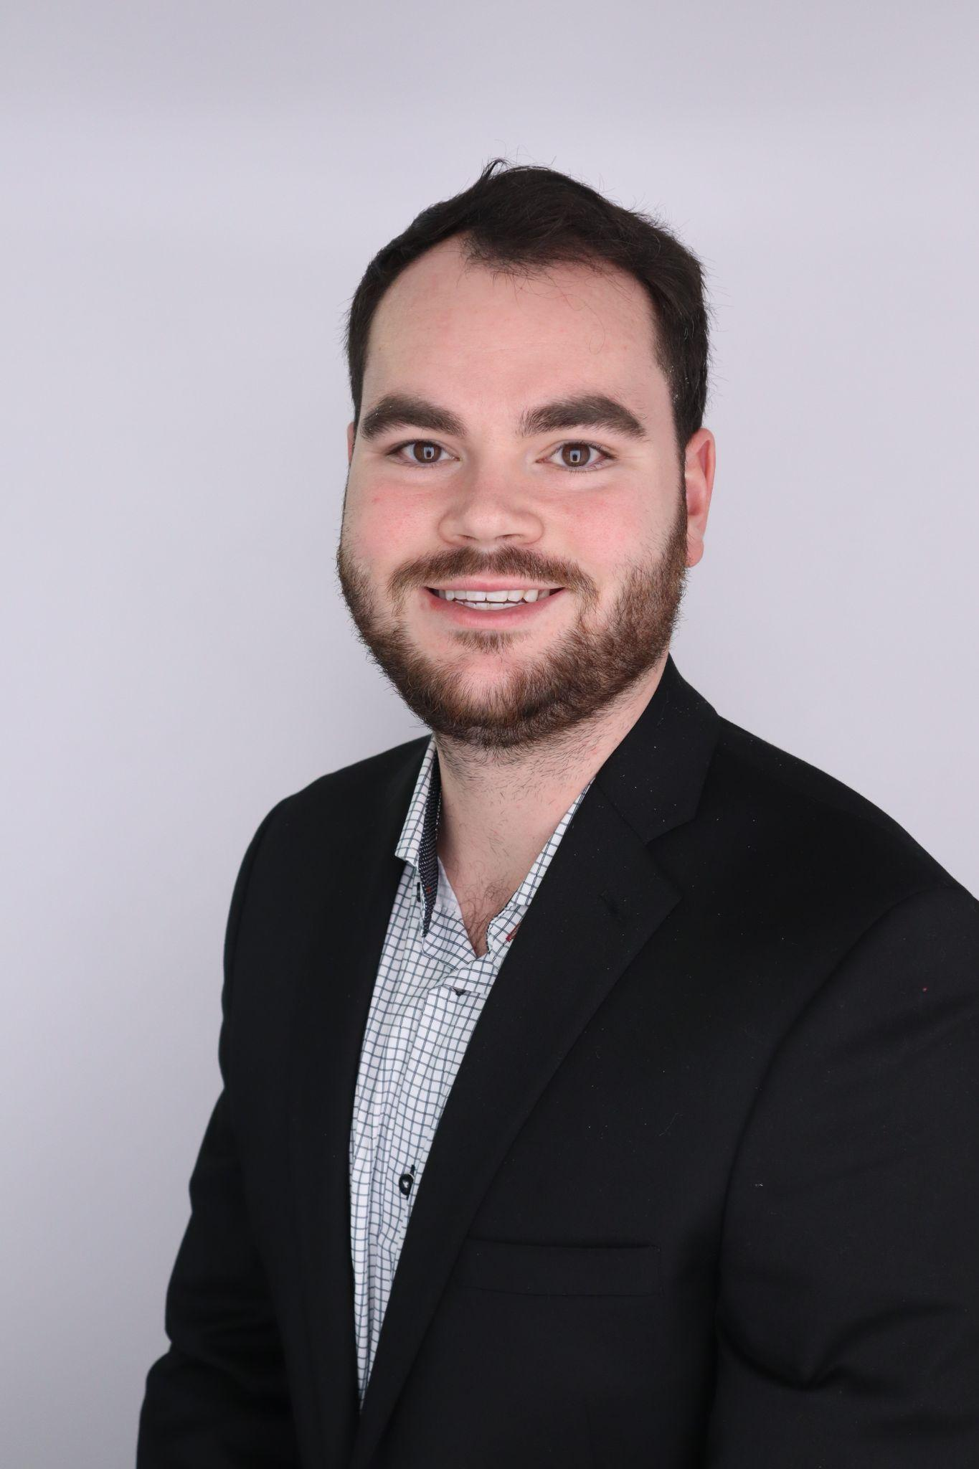
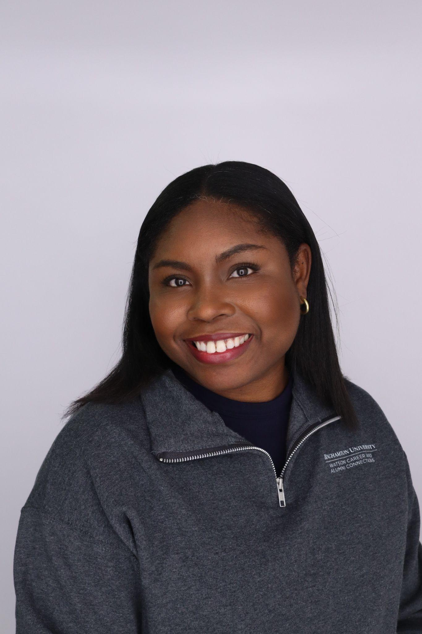
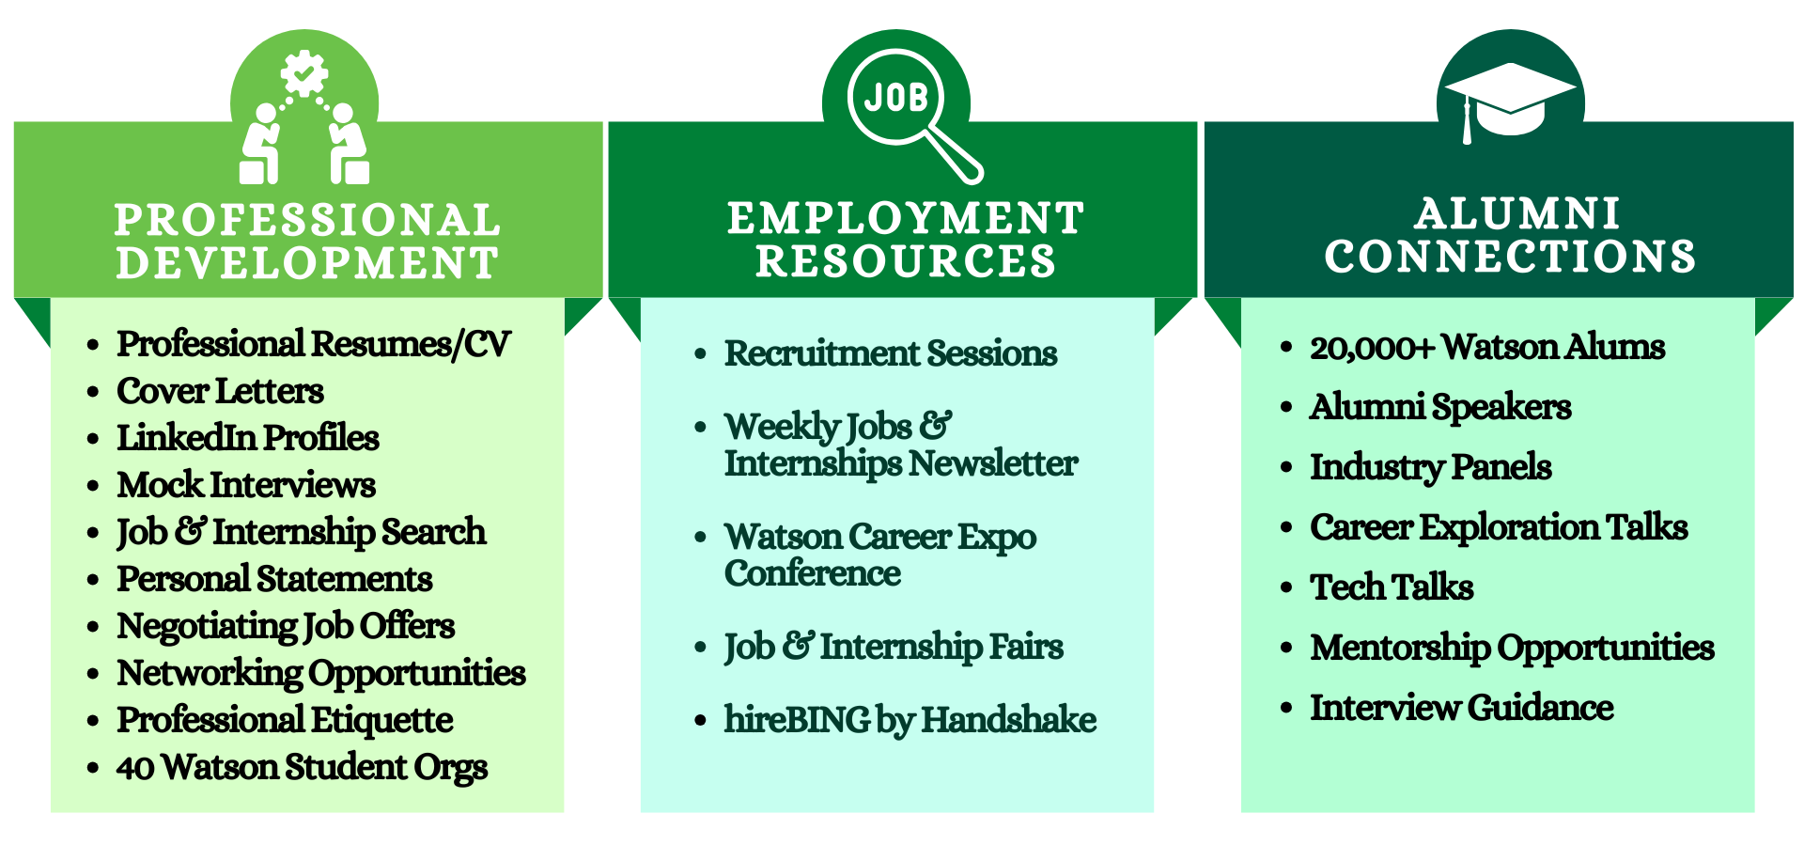
WCAC Staff Members (2025-2026)
Kimberly Eiche
Director
Stacey Brown
Assistant Director
Ashley Misuraca
Senior Employer
Relations Coordinator
Jacob Weinheimer
Alumni Relations
Coordinator
Kendra Woods
Administrative
Coordinator
Notes:
Stacey

Slide 3
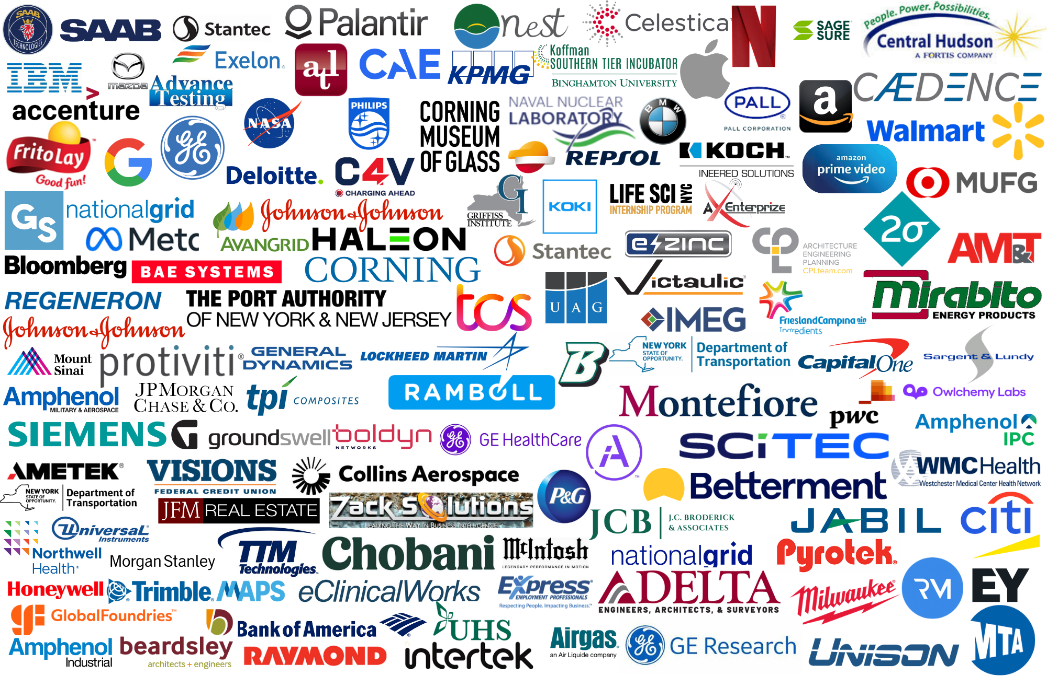
Which companies recruited Watson students for jobs/internships through WCAC initiatives in 2024-2025?

Slide 4
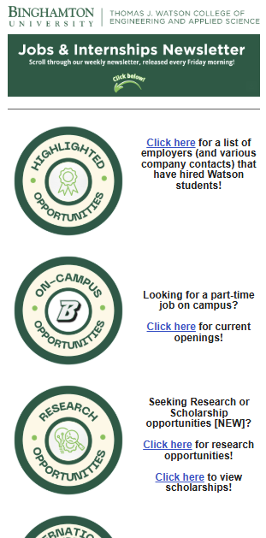



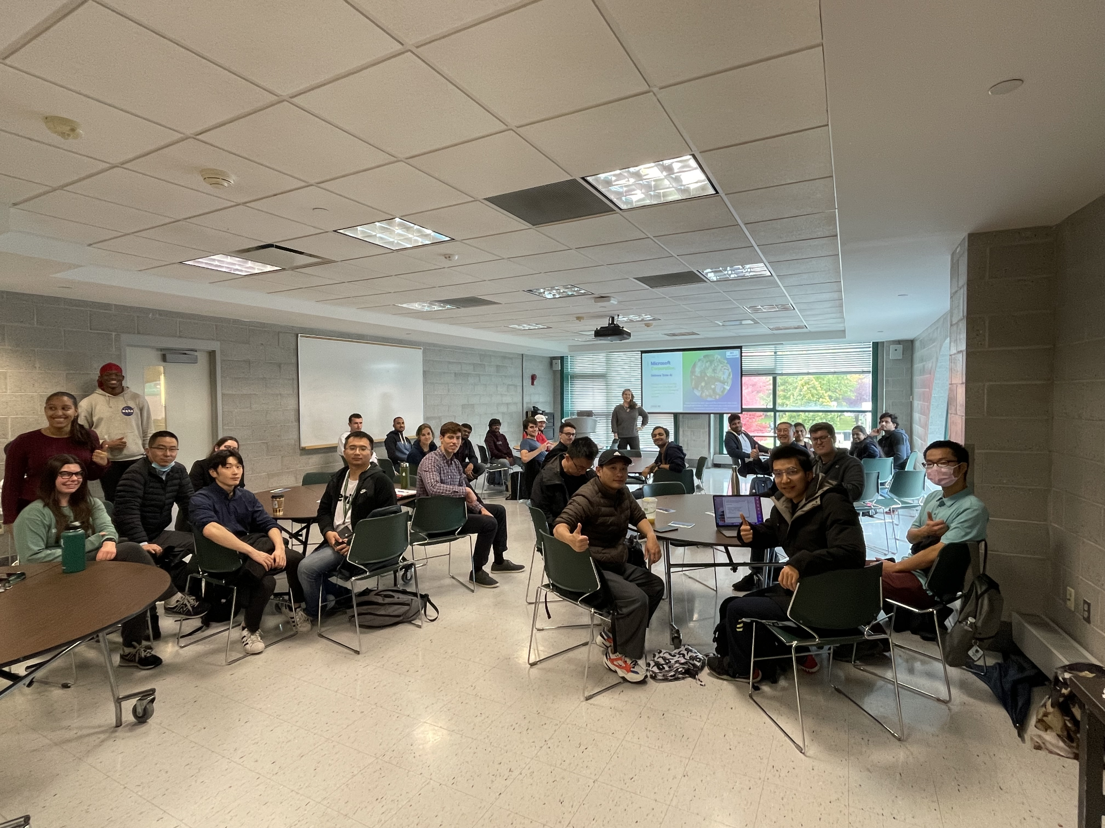
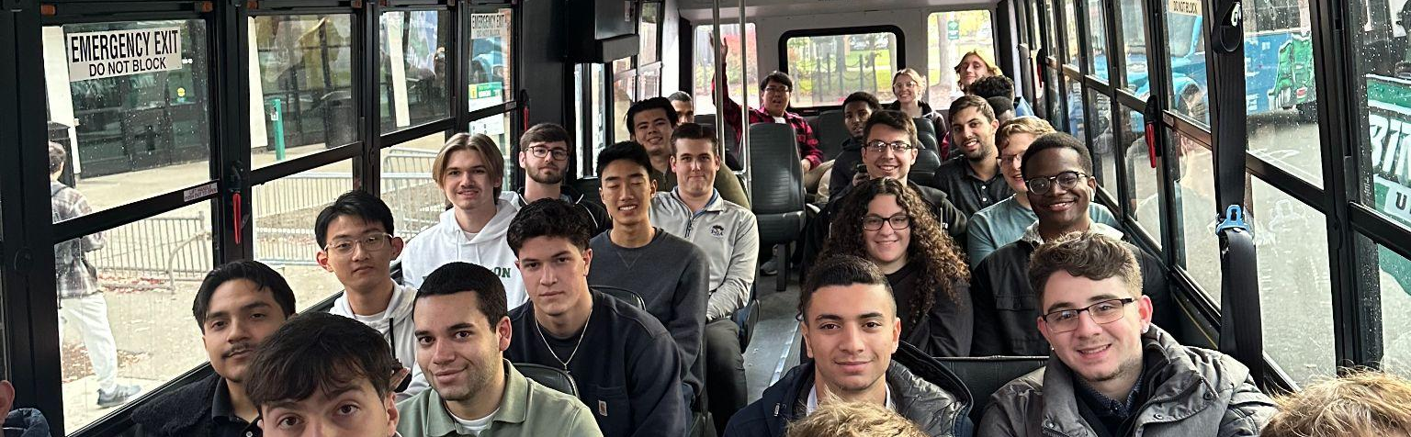




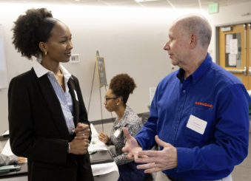






WCAC Company Recruitment Offerings
Recruitment Events
Career Fairs
Classroom Presentations
Watson Student Organization Collaborations
Industry Tours
GrIP
Watson Graduate Internship Program
Examples:
Tech Talk or demo of new equipment/product
On-site interviews
Alumni panel & info session
Facilitated initiatives to fit needs
i.e. guest lectures, capstone student projects, etc.
Fall and Spring options!
Notes:
Ashley

Slide 5
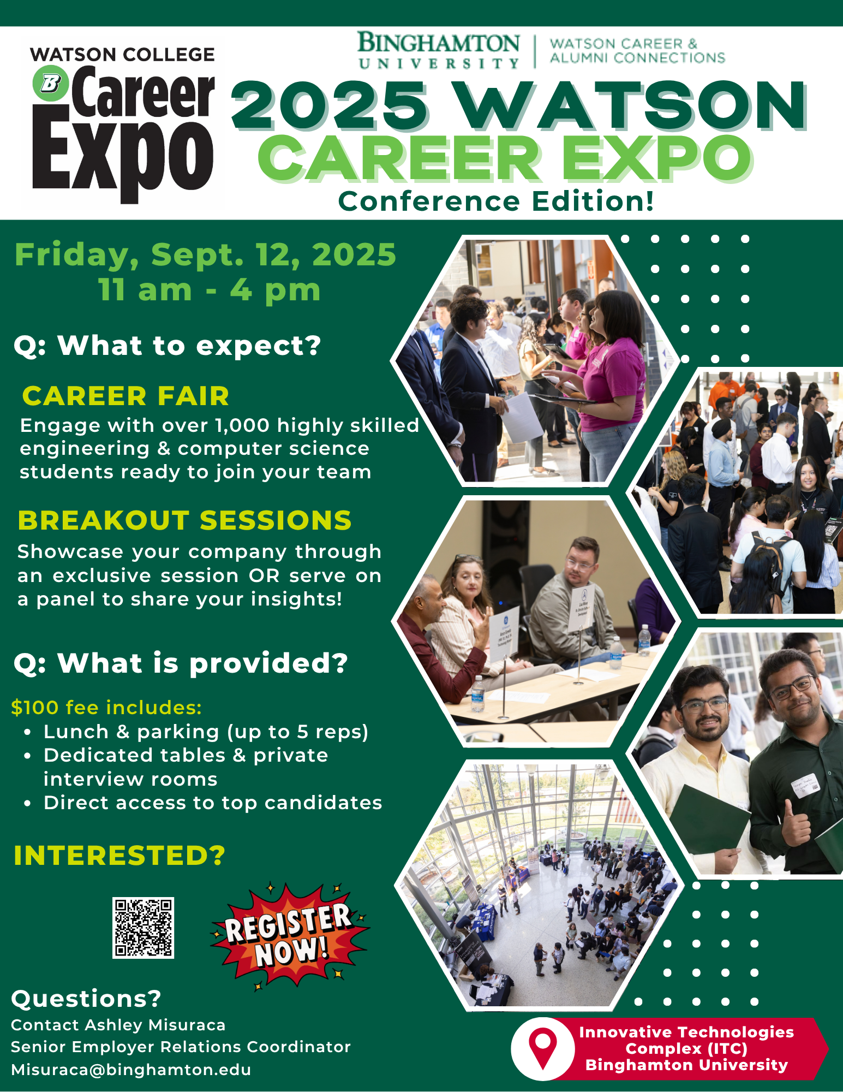

Slide 6

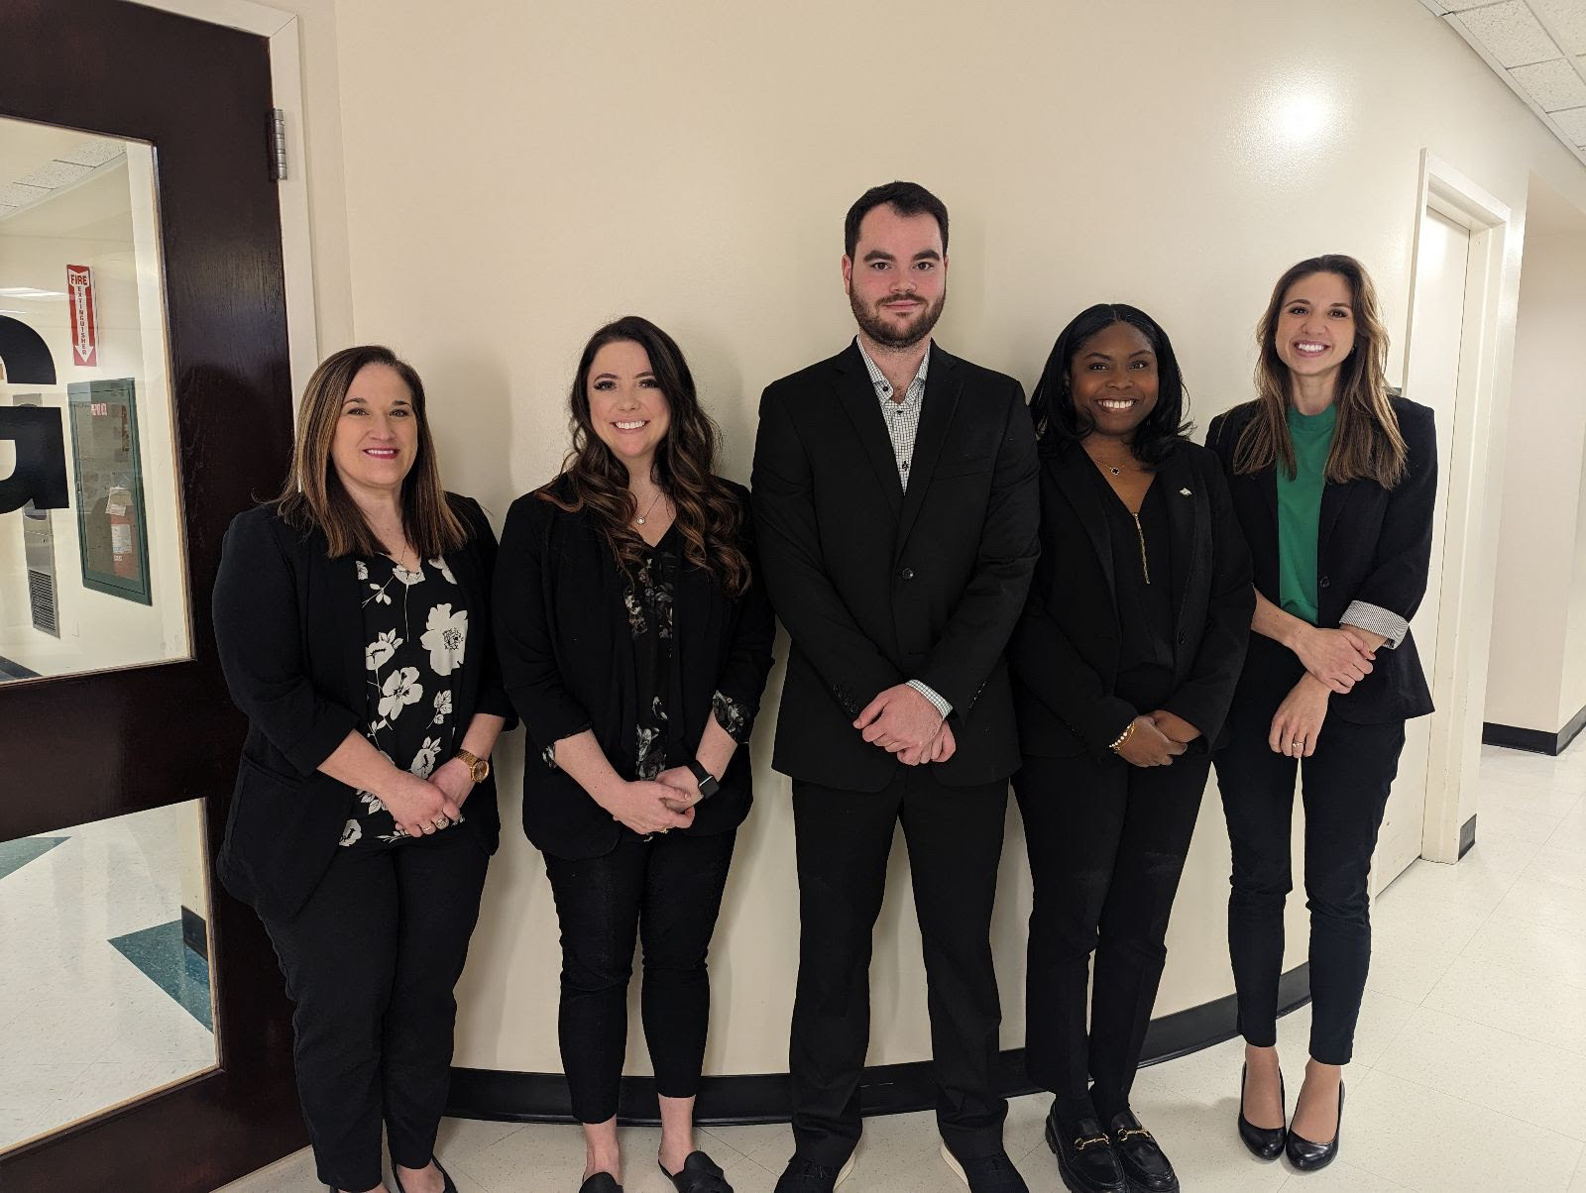
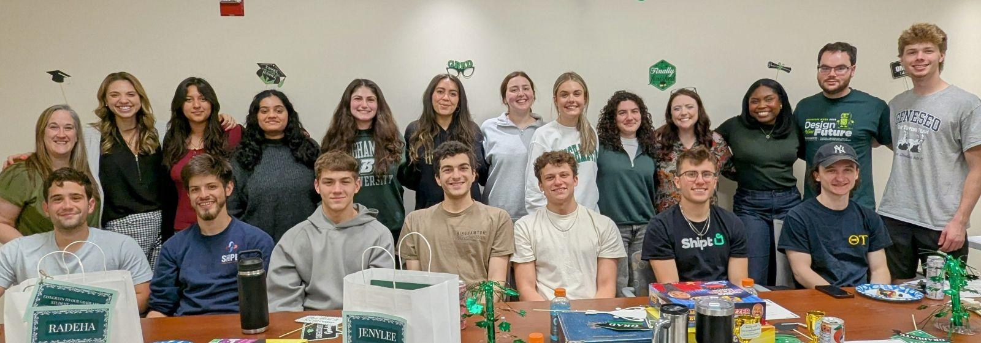
We look forward to working with you!
Kimberly Eiche, Ph.D.
Director, Watson Career and Alumni Connections
keiche@binghamton.edu | 607-777-4578
Stacey Brown
Assistant Director
sbrown15@binghamton.edu | 607-777-4573
Ashley Misuraca
Senior Employer Relations Coordinator
misuraca@binghamton.edu | 607-777-4569
Jacob Weinheimer
Alumni Relations Coordinator
jweinheimer@binghamton.edu | 607-777-6143
Kendra Woods
Administrative Coordinator
kwoods@binghamton.edu | 607-777-5202

Slide 7
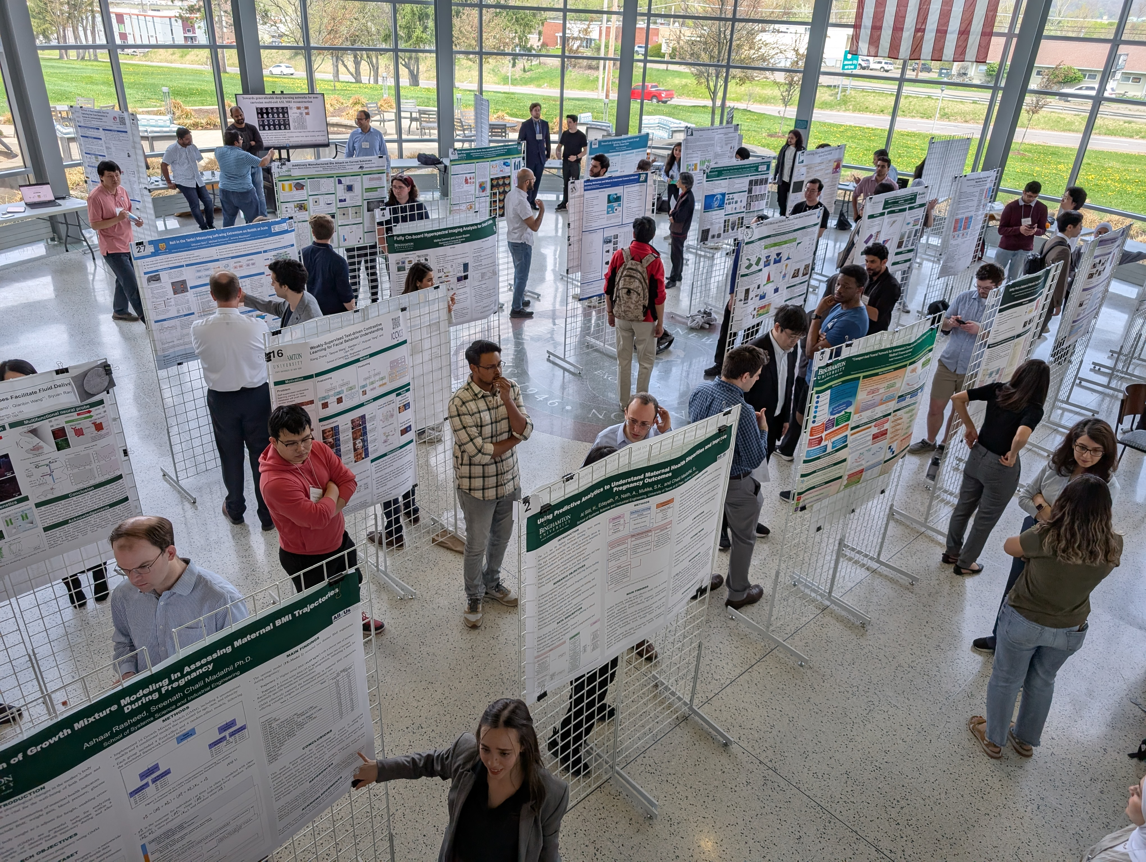
Watson College Graduate Internship Program (GrIP)

Slide 8
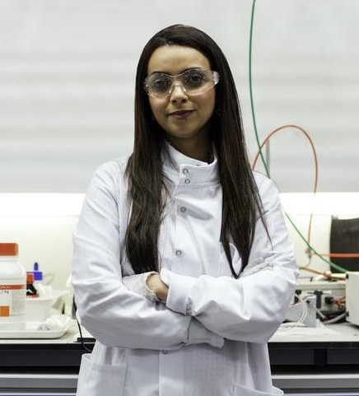
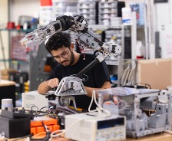
Program Overview
7-month, paid by industry internship for MS students
Employers hire MS students who demonstrate strong capabilities and a high level of professional maturity as interns
Student Eligibility: Completed 1 year in MS program, in good standing*
*students will apply during their 1st semester as an MS student

Slide 9
Mutual Benefits
Employers have an extended period to assess interns, with no obligation to hire
Employers reduce onboarding/training costs if intern is hired
Employers support internal mentorship and leadership growth
Students gain leadership & industry experience
Enhances real-world experience for students and academic integration into the internship
GrIP promotes university-industry collaboration on engineering & technology challenges

Slide 10
GrIP Proposed Timeline
June-July:
Industry partners attend info session or have 1:1 meetings about program with Watson College Staff
July-August:
Industry partners secured with letter of interest
September-November:
Applications posted to Handshake for students to apply
November-December:
Industry partners make decisions
Note: Timeline is flexible

Slide 11

WCAC: Kimberly Eiche, keiche@binghamton.edu Ashley Misuraca, misuraca@binghamton.edu Executive Assistant Dean for Graduate Studies: Hiroki Sayama, sayama@binghamton.edu Assistant to the Dean: Leana Testani, ltestani@binghamton.edu
Contact Us:

